Slide 1
CSML1010 – Milestone 1
Group 11 – Alex Fung and Patrick Osborne
Instructor – Dr. En-Shiun Annie Lee

Slide 2

Twitter US Airline – Sentiment Analysis
Milestone 1
Feature Engineering
Feature Selection
Benchmarking
Feature Engineering
Idea is to pull as much information out of the text as we can
Various ways of parsing and interpreting the text
Feature Selection
Too many features – will overwhelm our model. Need to keep the best and discard the rest

Slide 3
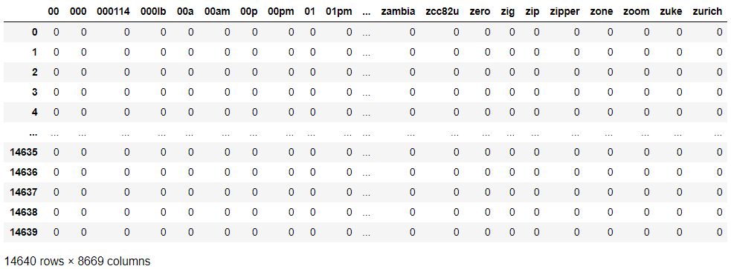

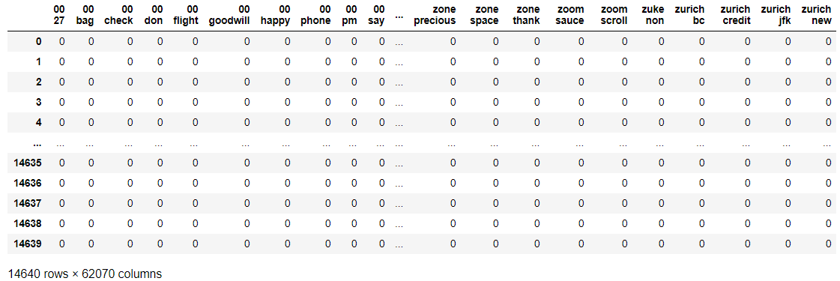
Feature Engineering – Basic Methods
Bag of Words
Bag of N-Grams

Slide 4
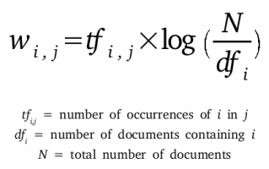
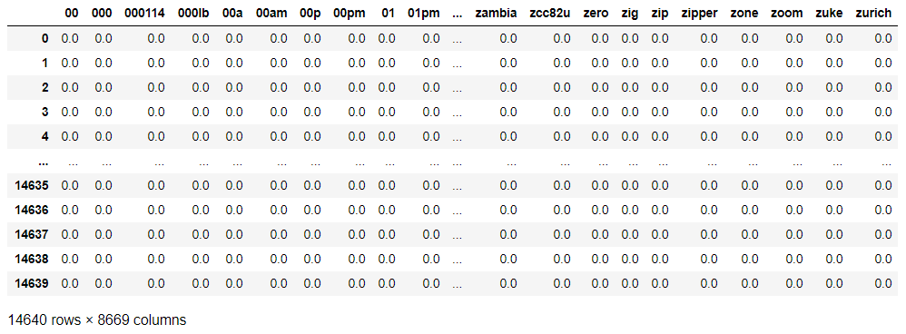
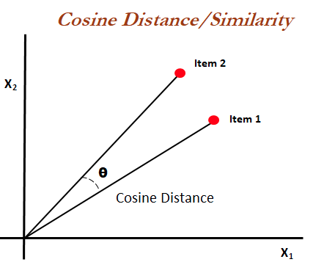
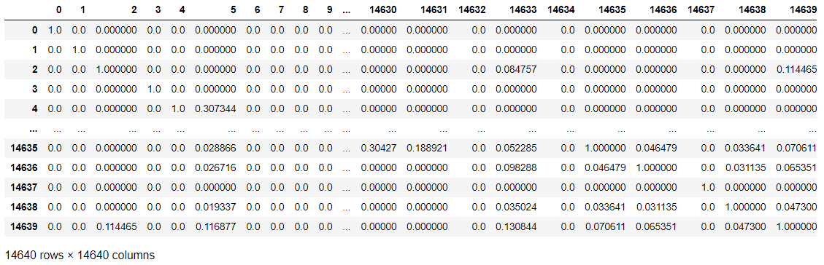
Feature Engineering – Basic Methods
TF-IDF
Cosine Similarity

Slide 5
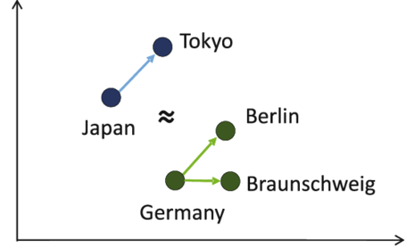
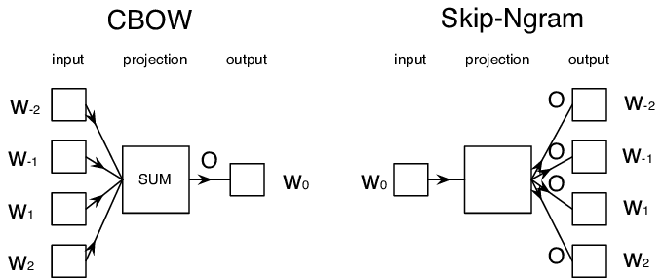
Feature Engineering – Word2Vec
Word2Vec
A form of word embedding
Represent individual words in a way that
similar words are represented in similar
ways
Generates numerical vectors
CBOW vs Skip-gram
Frequency/speed/accuracy trade-offs

Slide 6



Feature Engineering – Word2Vec - Models
Tensorflow / Keras Trained
Manual process
Slow even when GPU accelerated
Gensim Trained
Very fast
Possibly less fine-grained control
Google Pre-Trained
Fastest
Advantage of training on existing corpus
Cannot custom train to our dataset

Slide 7

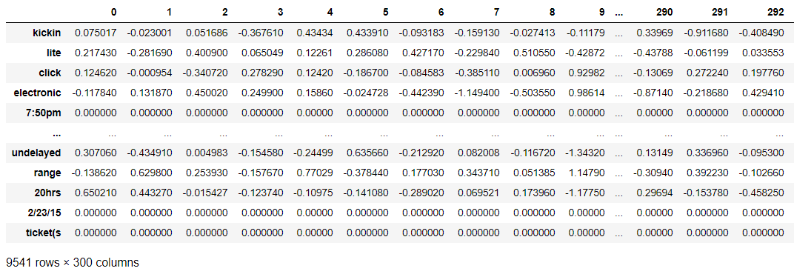
Feature Engineering – GloVe
GloVe Word Embedding
Global Vectors for Word Representation
An alternate model

Slide 8
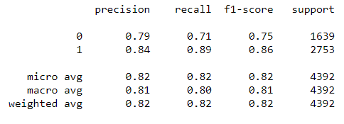
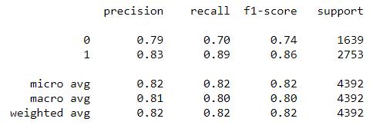
Benchmarking – Logistic Regression
Gensim Word2Vec Word Embeddings
Google Word2Vec Pre-Trained Word Embeddings

Slide 9
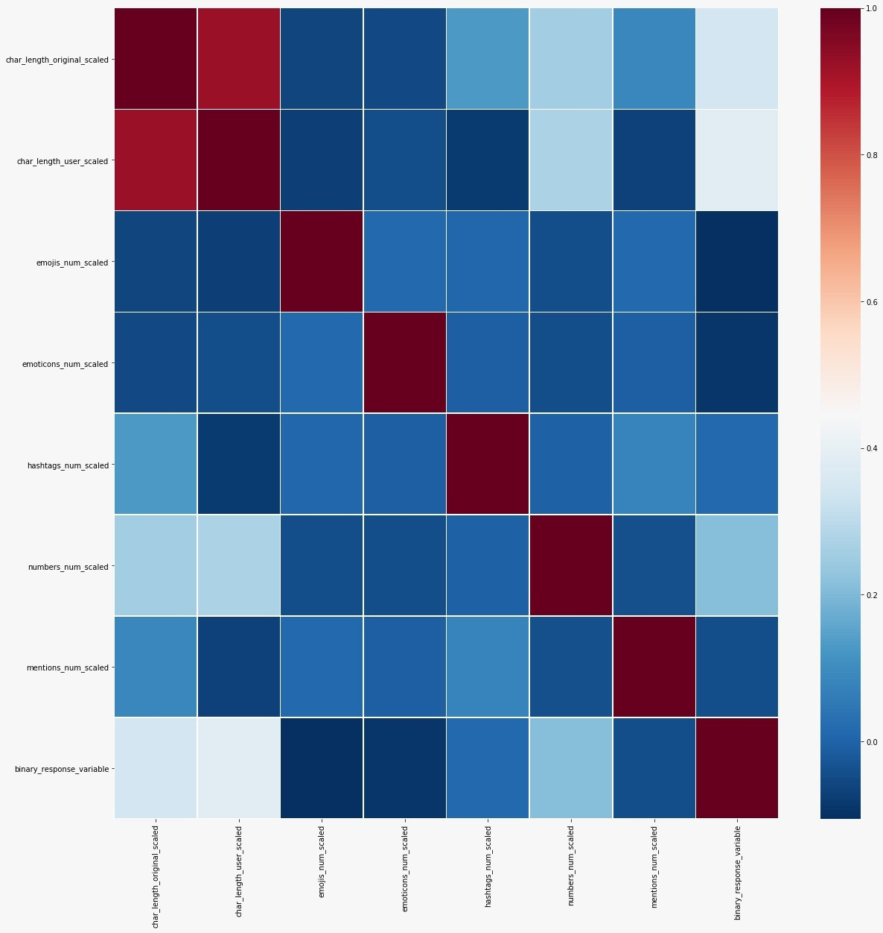
Feature Selection
Correlation Matrix
of
Engineered Features

Slide 10
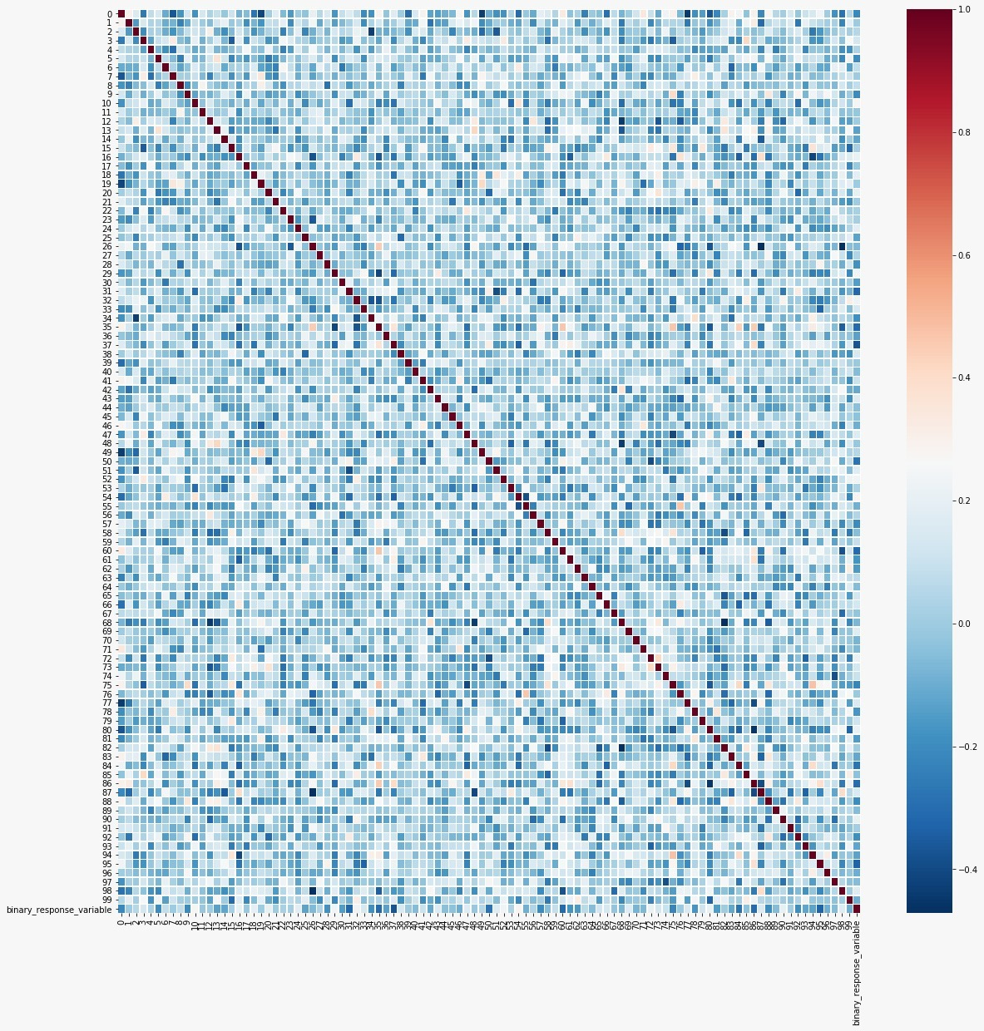
Feature Selection
Correlation Matrix
of
Gensim word2vec

Slide 11
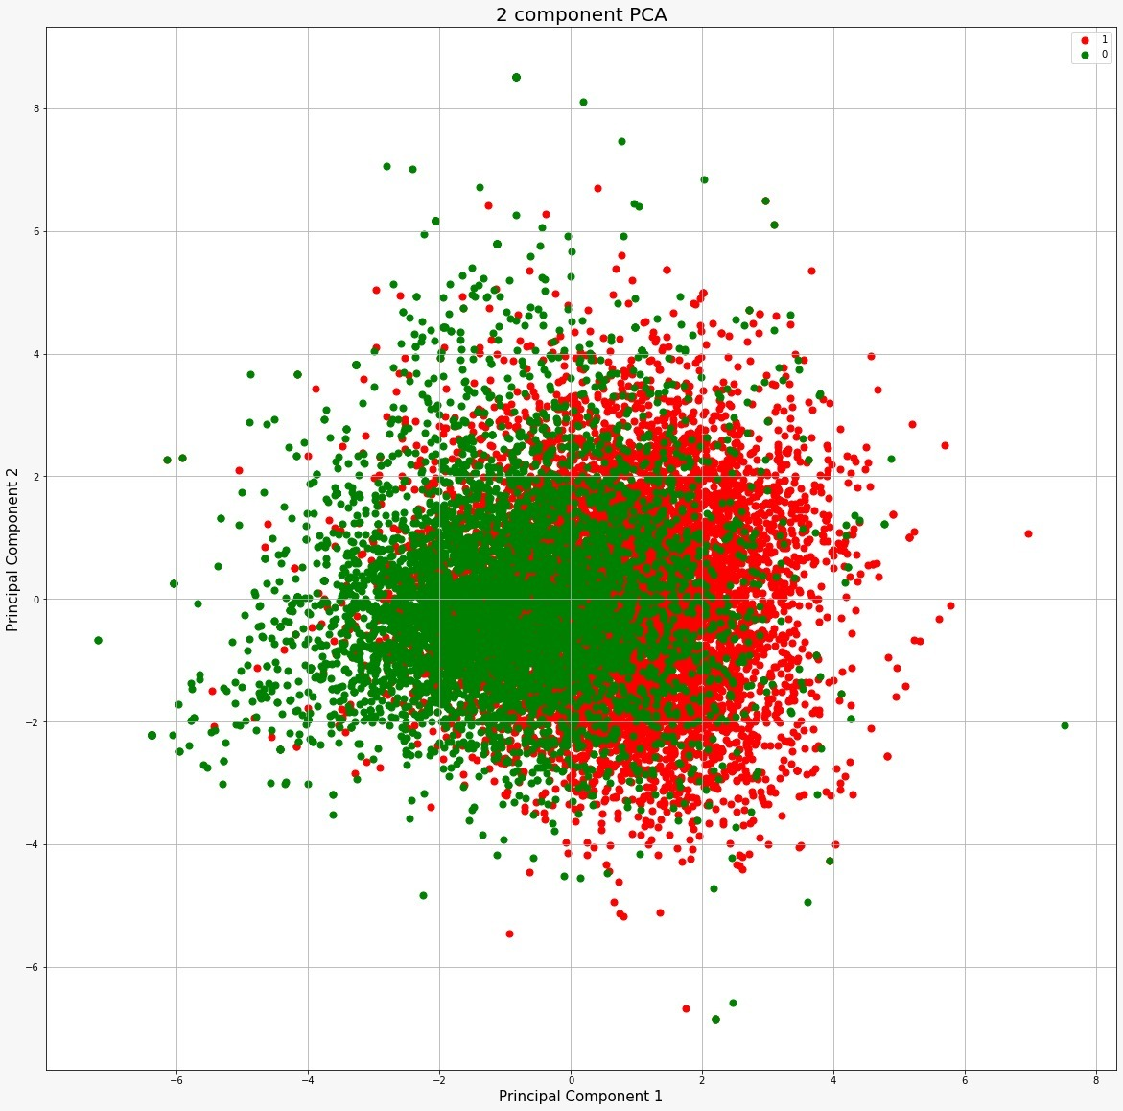
Principal
Component
Analysis
(Dimensionality
Reduction)

Slide 12
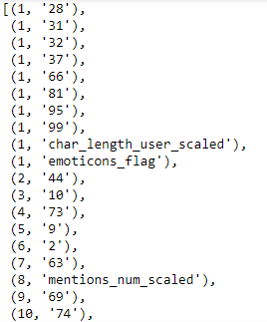
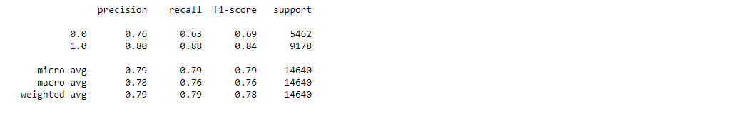
Feature Selection
Top 10 Features Ranked
Recursive
Feature
Elimination
Benchmark Results

Slide 13
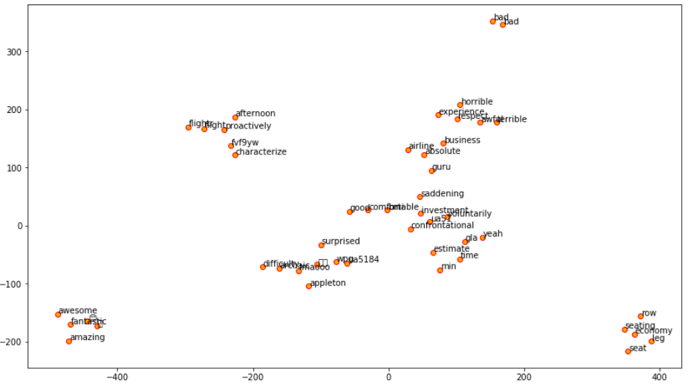
Feature Exploration
Gensim Word2Vec

Slide 14
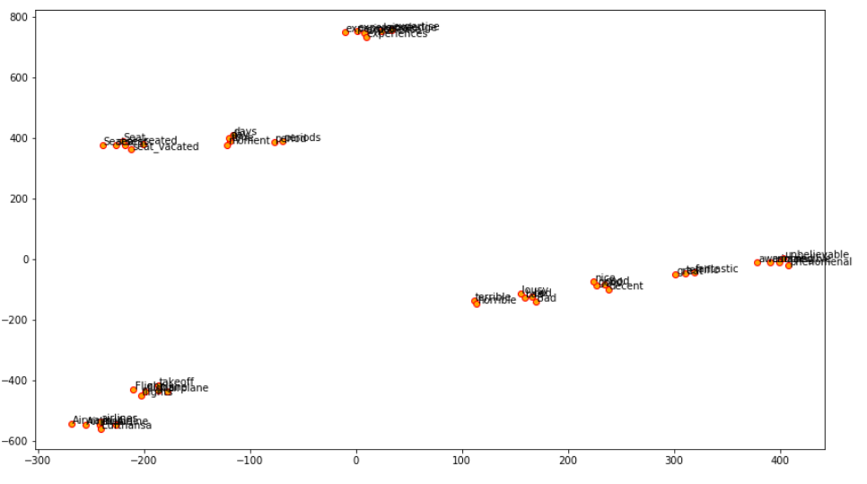
Feature Exploration
Google Word2Vec

Slide 15
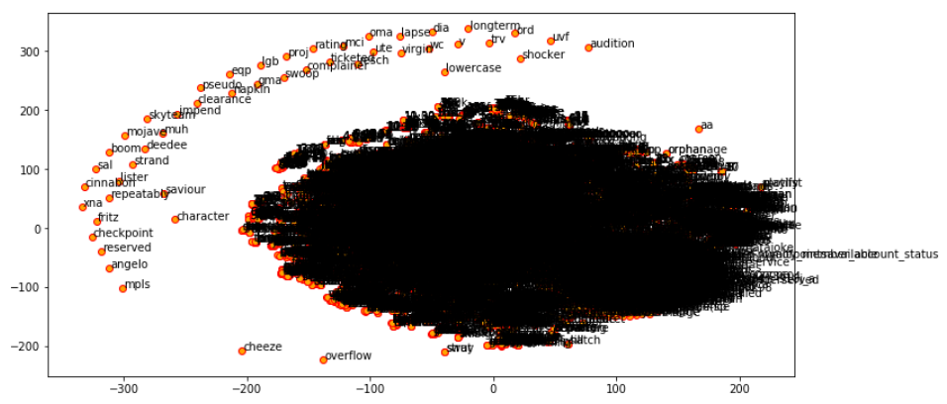
Feature Exploration
GloVe
All word embeddings

Slide 16
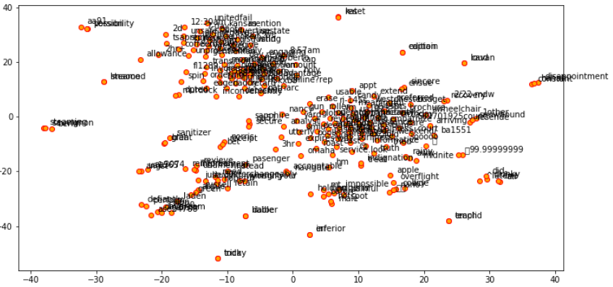
Feature Exploration
GloVe
250 item sample

Slide 17
Thank You!

